Slide 1

   ’
By Vance Bloom

Slide 2

Decisions, Decisions, Decisions!
So many choices!
Such a difference in price!
Which one is the best choice?

Slide 3

Considerations
Things to think about!
How long do you want them to last?
How much money do you have to spend?
What type of driving do you do?
Where do you live?
What driving conditions are you likely to encounter?

Slide 4
How long do you want them to last?
Obviously, everyone wants their tires to last as long as possible!
Just because a tire is more expensive, does not necessarily mean it will last longer!
Avoiding hard cornering, braking, and burn-outs as well as keeping your car in alignment with proper tire inflation will help your tires last longer!

Slide 5
How much money do you have to spend?
Tire prices vary greatly and sometimes the cheapest tire is not necessarily the most economical choice!
Sometimes the more expensive tire is the more economical choice in the long run!
Just because a tire is more expensive, does not necessarily mean it will be better for you!

Slide 6
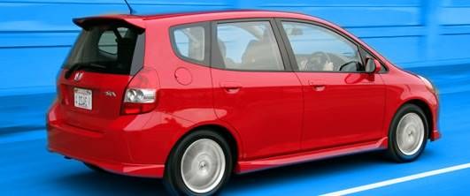
What type of driving do you do?
Do you drive mostly at low speeds around town?
Do you drive mostly on the freeway at high speed?
Do you drive on mountainous roads?
Do you drive around corners at 90mph???
Do you drive a combination of these?

Slide 7
Where do you live?
Do you live in the desert?
Do you live in the mountains?
Do you live in Alaska?
Do you live in the city?
Do you live in a zoo?

Slide 8
What driving conditions are you likely to encounter?
Do you go off roading?
Do you drive on curved mountain roads?
Do you drive in the snow?
Do you drive on the freeway?
Do you drive like a monkey?

Slide 9
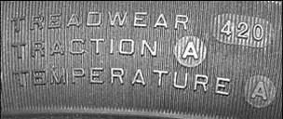
The Three “T”s
T = Tread Wear
T = Traction
T = Temperature
Memorize these three!
There will be a Quiz!

Slide 10
Tread Wear
Tread wear is rated using a number system.
The numbers start at 100 and go up as the tire is rated for better lasting wear.
A tire that has a rating of 300 would be expected to last three times as long as a tire rated at 100 under similar driving conditions.
You want to buy a tire that has the highest wear rating for the best price.
Spending 30-40% more money for a tire with double the tread wear rating is well worth it.

Slide 11
Traction
Traction is rated using a letter system.
The letters start at “C” and go up to “AA” as the tire is rated for better traction.
A tire that has a traction rating of “A” would be expected to grip the road surface during cornering and braking far better than a tire with a “C” rating.
Depending on where you live and how you drive, traction may be very important to you.

Slide 12
Temperature
Temperature is rated using a letter system.
The letters start at “C” and go up to “A” as the tire is rated for better resistance to high and low temperatures
A tire that has a temperature rating of “A” would hold together better than one that is rated “C” during freeway driving in the summer heat out in the desert. (Have you noticed shredded truck tires on the freeway in the summer?)
Depending on where you live and how you drive, the temperature rating may be very important to you.

Slide 13
Points to Remember
Tread Wear – Higher the number the Better!
Traction – “AA” is Best!
Temperature – “A” is Best!
Don’t hesitate to ask the tire sales person to find out what these ratings are on the tires that you are interested in buying. When the sales person finds out that you know what you are talking about, he/she should steer you towards the best value for your individual needs!
SHOP AROUND, even the same tires vary in price from store to store.

Slide 14
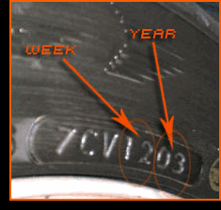
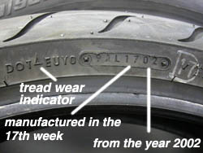
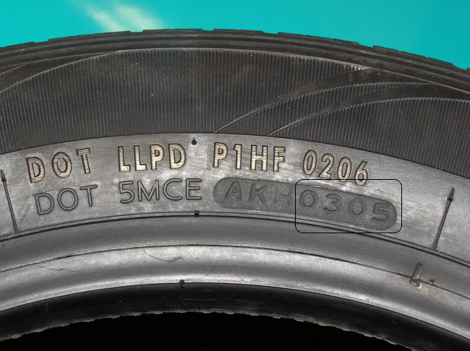
One More Thing
MAKE SURE YOUR NEW TIRE IS NEW!
Check the manufacturing date on the inside of the tire (BEFORE YOU BUY IT!).
YOU DON’T WANT TIRES OVER 6 YEARS OLD ON YOUR VEHICLE!

Slide 15

Now a Quiz!
(Click on man below left to take paper quiz)
(Click on man below right to take online quiz)

